Slide 1
IW Writing Assignment – How to
UNCLASSIFIED

Slide 2
Terminal Learning Objective/Learning Domains
UNCLASSIFIED
Action: Discuss writing assignment expectations.
Condition: In a Virtual classroom or training site, with appropriate graphical training aids, various learning activities, and peer and instructor feedback the one hour assignment review informs student of expectations in their assignment.
Standard: Students write a 4-6 page essay that complies with ST 22-2 & this class.
Learning Domain | Level of Learning
Cognitive | Understanding Evaluate
Safety Requirements: No major considerations
Risk Assessment Level: Low
Environmental Considerations: None
Evaluation: Individual contribution, presentation skills, groups learning exercises, Checks on Learning, and practical exercises
Army General Learning Outcomes
3, 4, 5, 6, 9, 11, 12, 13, & 14
LSAs
LSA 1 – Discuss ST 22-2 Processes & Standards
UNCLASSIFIED
Notes:
Take a moment to review the information on this slide.
GLOs
ALA: Army Leadership and Profession
Soldiers and Civilians proficient in leader attributes and competencies. This GLO includes: Leader Development, Counseling, Coaching, and Mentoring.
Soldiers and Civilians proficient in character, competence, and commitment as Trusted Army Professionals. This GLO includes: The Army Profession, Ethic, and Character Development.
ALA: Mission Command
3. Soldiers and Civilians demonstrate proficiency in mission command philosophy. This GLO includes: Build Teams through Mutual Trust, Create Shared Understanding, Provide Commander’s Intent, Exercise Disciplined Initiative, Use Mission Orders, and Accept Prudent Risk.
4. Soldiers and Civilians demonstrate proficiency in mission command leader and commander tasks. This GLO includes: Lead the Operations Process, Inform and Influence Relative Audiences, Develop Teams within Units and Unified Action Partners, Art of Command/Science of Control, Pre-Combat Inspections, Lead the Unit, Organize Staff for Operations, Rapid Decision and Synchronization Process, and Troop Leading Procedures.
5. Soldiers and Civilians demonstrate proficiency in mission command staff tasks. This GLO includes: The Operations Process (MDMP and Design Methodology), Information-related Capabilities, Knowledge Management, and Cyber-Electromagnetic Activities.
6. Soldiers and Civilians demonstrate proficiency in mission command systems. This GLO includes: Common Operating Picture and Mission Command Information Systems.
ALA: Human Dimension
7. Soldiers and Civilians demonstrate capacity in creative-critical thinking. This GLO includes: Applied Critical Thinking and Groupthink Mitigation, Strategic Thinking, Problem Solving, and Decision Making.
8. Soldiers and Civilians demonstrate proficiency in communications skills. This GLO includes: Verbal, Written, Active Listening, Facilitation, Negotiations, Social Media, and Digital Communications.
9. Soldiers and Civilians demonstrate proficiency in cultural awareness, cross cultural competencies in the strategic environment of 2025 and beyond. This GLO includes: Strategic Communications, Public Affairs Awareness, and Joint Inter-Governmental and Multi-National Relations.
10. Soldiers and Civilians pursue Comprehensive Fitness/Resiliency Skills and Performance Enhancement Skills. This GLO includes: Physical, Social, Emotional, Spiritual, and Family Fitness.
11. Soldiers and Civilians pursue lifelong learning, self-assessment, and goal setting. This GLO includes: Development of Soldiers and Civilians with intellectual diversity and capacity through innovative learning programs to succeed in complex, operational environments.
ALA: Professional Competence
12. Soldiers and Civilians demonstrate proficiency in Army and Joint Activities. This GLO includes: Unified Land Operations, National Security Policies, and Military Strategies and Capabilities.
13. Soldiers and Civilians support Army policies, programs, and processes. This GLO includes: Understanding and contributing to Army Systems that manage, develop, and transform the Army and sufficient business and organizational management acumen at assigned echelon/unit level to allow innovation and entrepreneurship.
14. Soldiers and Civilians are technically and tactically competent. This GLO includes: Branch and Career Management Field proficiency, Career Programs, Series Technical Certifications, and Warfighting Skills.

Slide 3
UNCLASSIFIED
IW Writing Assignment – How to
For Cyber Captains Career Course,
Cyber and Electromagnetic Warfare School
United States Army Cyber Center of Excellence
UNCLASSIFIED

Slide 4
Purpose
UNCLASSIFIED
To ensure students understand writing assignment expectations
UNCLASSIFIED

Slide 5
Outcome
UNCLASSIFIED
Students achieve a 70% or higher on IW essay by following ST 22-2 and this module.
UNCLASSIFIED

Slide 6
Learning Objective
UNCLASSIFIED
LSA 1: Discuss ST 22-2 Processes and Standards
UNCLASSIFIED

Slide 7
Why are we doing this
20% of students received a 70 or below grade on the last assignment.
*The only way to get better is to write more. If you need to get better, we’ll help you.
It’s better to stumble here then when you’re handing your rater or SR a white paper, speech, or quarterly training guidance.

Slide 8
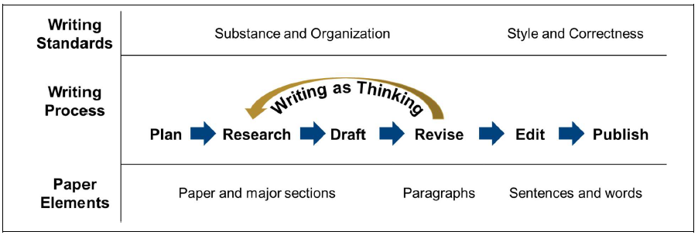
The Writing Process
Notes:
Review the process with the students.

Slide 9
Planning
In 750 words or less, analyze the Egyptians’ crossing of the Suez Canal in the 1973 Arab-Israeli War. Use current Army doctrine as your analysis framework.
This prompt gives three tasks:
1. Analyze the crossing of the Suez Canal.
2. Use current Army doctrine as the analysis framework.
3. Keep the essay to 750 words or less. The writer must meet all three requirements.
If not, they have failed to meet the most important writing standard: write to achieve the purpose.

Slide 10
Planning – IW paper Prompts
Write an at least five-page paper, not including title or reference page, on one of the following prompts:
Pick one article presented and explain the potential impacts /findings of the arguments on the future of the branch? Explain what the DoD can do to better the outcome.
Pick one article and write a cause-and-effect essay detailing potential outcomes if the article findings come true. Project what the worst and best outcomes could be and what the DoD failed to do or did to change the outcome.
OR
With Cadre approval, write a five-page essay on Information Warfare, Information Advantage, and what the branch should do.
What are the requirements?

Slide 11
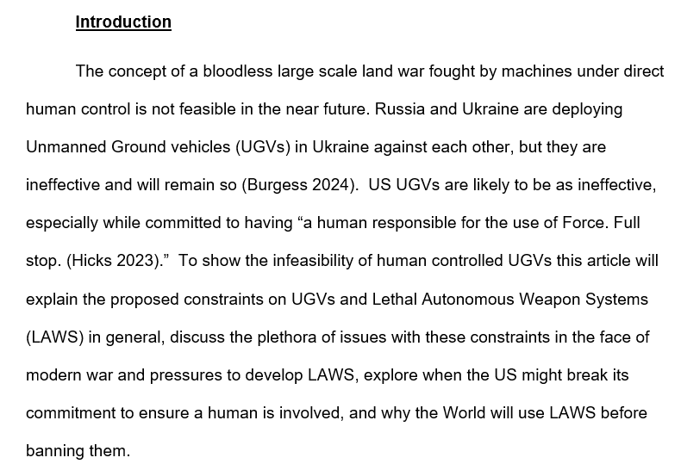
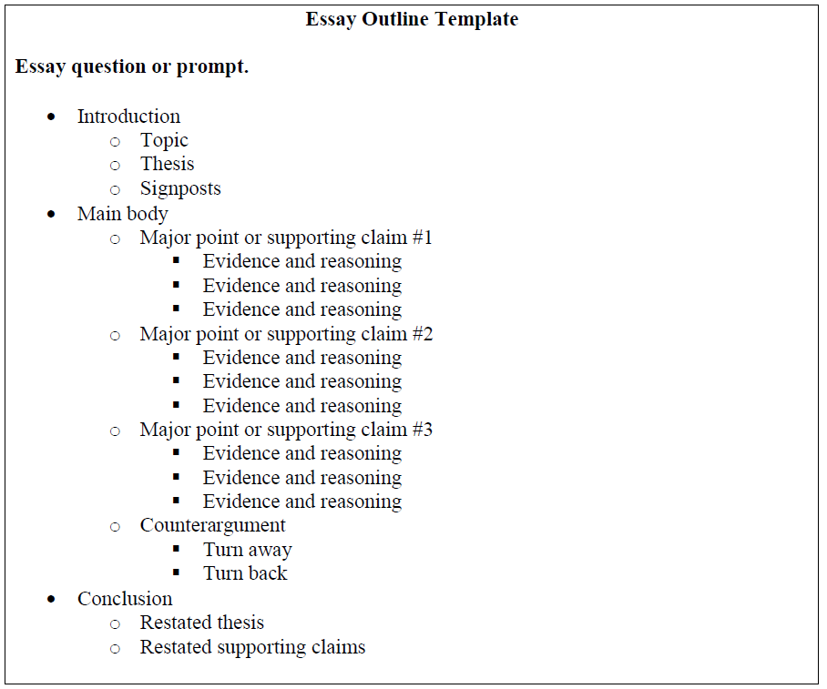
Research
Draft a thesis (your main arguments).
What evidence or reasoning supports your thesis?
CITE! Keep track of your sources and associated facts.
Start a skeleton:
You should walk into the IW Conference with this.

Slide 12
Drafting 1/2
You don’t need a “hook” to get attention in professional writing
Tell the reader what to expect.

Slide 13
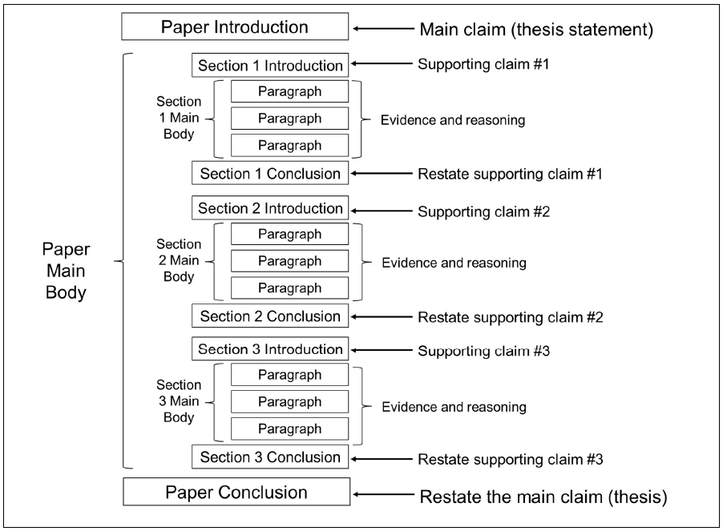
Drafting 2/2

Slide 14
Revision
Questions to ask during paper revision include:
Does the paper achieve its purpose? Does it answer the question(s) or complete the required task(s)?
Does the introduction discuss the topic, state the thesis, and signpost the major points?
Is the thesis statement clear? Does it appear early in the essay?
Does the main body support the thesis? Does each major section and paragraph build support for the main idea?
Is the main body logically structured? Do the major sections and paragraphs appear in a logical order?
Is everything in the main body relevant to the thesis (see murder your darlings below)?
Does the conclusion restate the thesis and the main points? Do the introduction and conclusion agree?

Slide 15
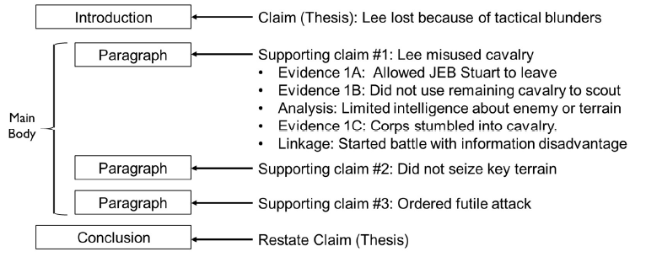
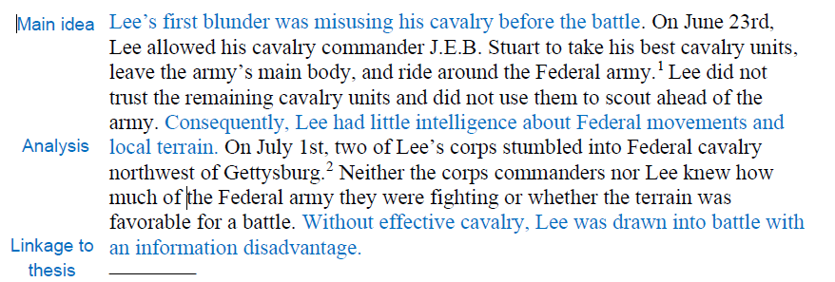
Revision – Paragraph Structure
The topic sentence states the paragraph’s main idea.
The middle sentences discuss the evidence and analysis that support the main idea.
The last sentence links the paragraph to the main idea of the paragraph, section, or paper.

Slide 16
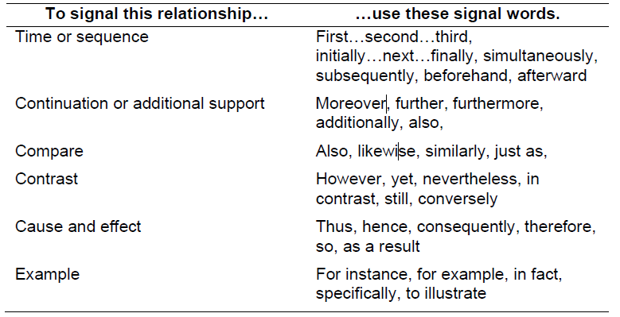
Revision – Paragraph Transitions
Signal Words
Transition Phrases
Transition Sentences (don’t use the topics sentence of the next paragraph as the transition out of the previous sentence).

Slide 17
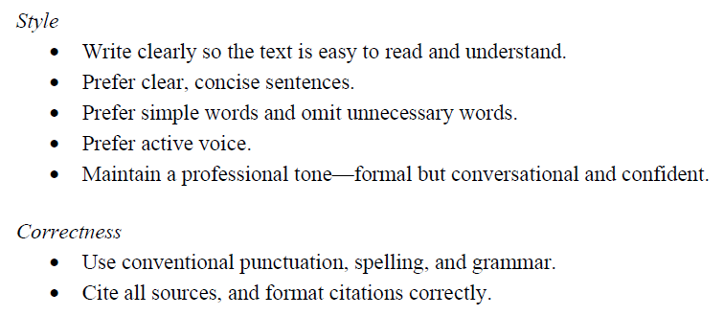
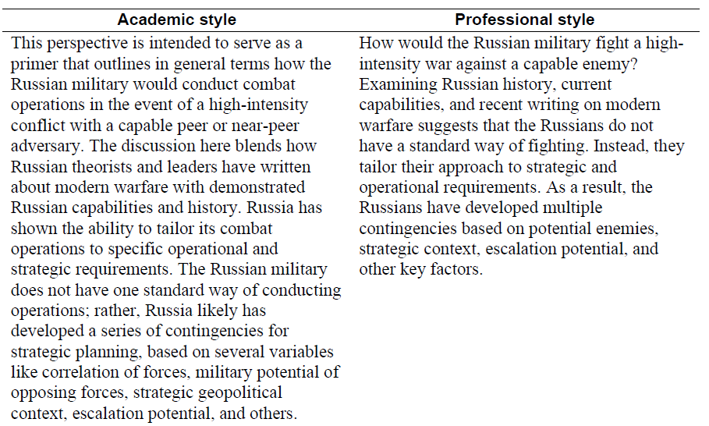
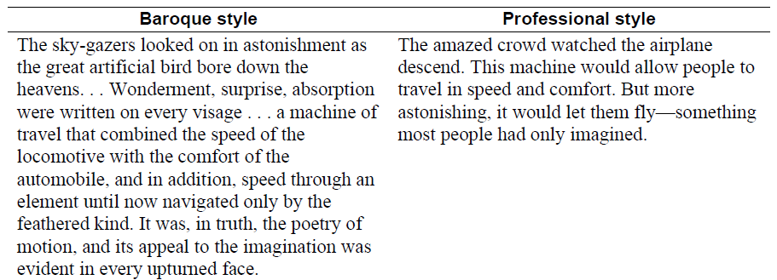
Edit
Take ST 22-2, pages 35-44 and have it next too you when you’re editing!

Slide 18
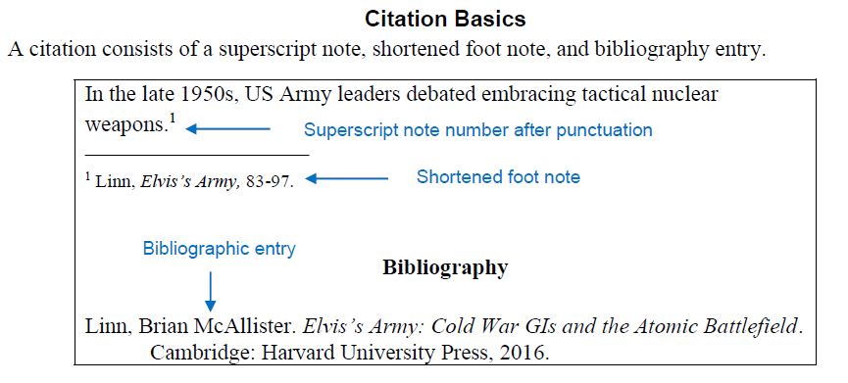
Publish
Proofread! Take have a peer review it, read aloud!
Cite Correctly
The example paper in your class calendar has a formatted paper!
Author say something relevant at the IW conference?

Slide 19
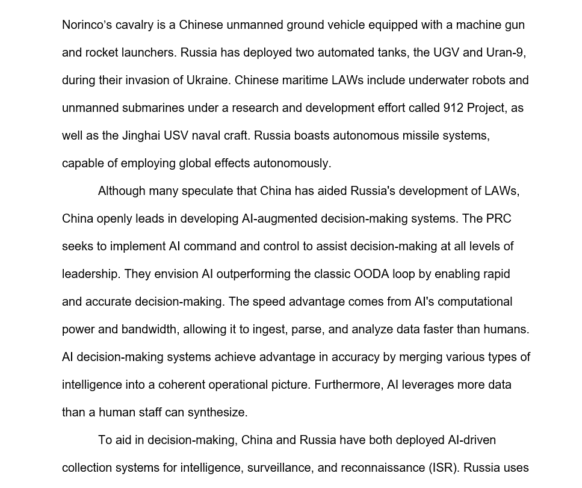
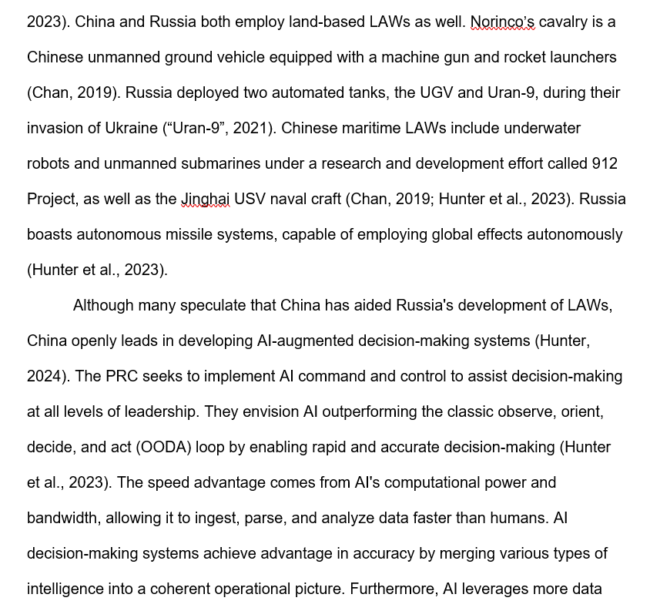
Not citing will be an automatic fail and redo
Initial Submission
After re-write

Slide 20
After the assignment
If a student fails, they’ll have three business days to do a re-write.
If a student doesn’t pass the second attempt, they’ll be required to attend writing classes with the library.

Slide 21
Check on Learning
What should you have when you get to the IW conference?
Essay outline
You’re writing this essay in what style?
Professional style.

Slide 22
Summary

