Slide 1
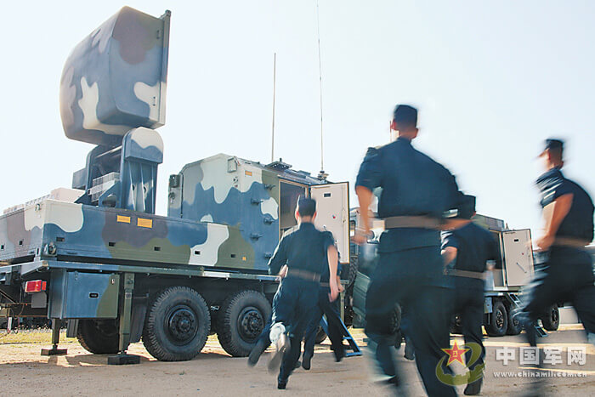
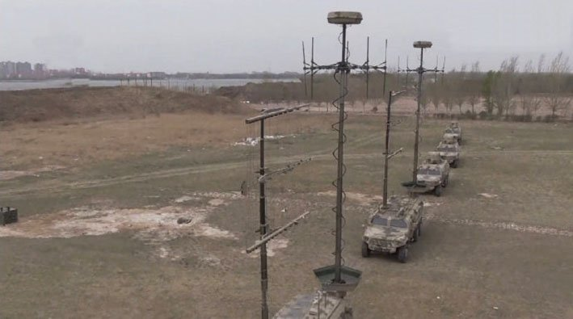
How They Fight Series
(U) China’s Electronic Warfare Operations
(U) This infographic describes Electronic Warfare Operations. Authoritative PLA writings identify controlling the “information domain”—sometimes referred to as “information dominance”—as a prerequisite for achieving victory in a modern war and as essential for countering outside intervention in a conflict. Electronic warfare is the workhorse in Chinese information operations and is frequently portrayed as inherently defensive (in the broadest sense of the term), pulling double duty as both a tool of coercion and information denial. China’s evolving concept of “cyber-electromagnetic sovereignty” raises the possibility that the PLA will one day declare the right to deny or degrade satellite reconnaissance aimed at its territorial claims and space-based platforms, which could indirectly be understood as holding its assets at risk, complicating U.S. efforts to project power in the region.
(U) The reforms have also established a national joint Network-Electronic Countermeasure dadui (brigade). Based on the ECM center’s public research, its mission appears to have focused on electronic support measures, electronic intelligence, and targeting in the electromagnetic domain. The similarities suggest the former ground force ECM centers were most likely reorganized into joint forces Network-Electronic Countermeasure brigades, expanding the scope of their mission to include network reconnaissance and targeting. These organizations suggest that the SSF does not, as some initially thought, have a monopoly of force in cyberspace, but rather continues to share the mission with other components in the PLA.
Strategic Support Force
Theater Command (Five Regional)
Army HQ
Navy HQ
Air Force HQ
Network- Electronic Bureau
Network- Electronic Bureau
Network- Electronic Bureau
Network Systems Department
Cyber, Electronic PsyOps
Joint Network-ECM Group
(U) ECM units are equipped with a range of modern ground-based electronic warfare systems capable of targeting large portions of the electromagnetic spectrum. PLAA ECM units use HF/VHF/UHF, radar, and UAV-borne jamming systems to support maneuver forces.
(U) Electronic warfare will be a key standoff weapon in any conflict that China is likely to fight, offering the potential to significantly diminish the intelligence collection, communications and information processing capacity of an adversary even as enemy units come within range of the growing web of air, submarine, surface, and missile threats that China is extending out along its periphery.
TRBs
AirDef ECM Brigade Beidaihe
54th RI
TRBs
Army ECM Units
1st Bureau
Army TRBs
56th RI
Navy ECM Units
2nd Bureau
ECM Brigade Langfang
….
56th RI
Navy TRBs
Air Force ECM Units
12th Bureau
ECM SAT Station Beijing
58th RI
Air Force TRBs
(U) Key: AirDef: Air Defense ECM: electronic countermeasure; EW: electronic warfare; HQ: headquarters; HF: high frequency; PLA: Peoples Liberation Army; PLAA: Peoples Liberation Army Army; PsyOps: psychological operations; RI: reconnaissance and intelligence; TRB: technical reconnaissance bureau; SSF: Strategic Support Force; VHF: very high frequency; UAV: unmanned aerial vehicle UHF: ultra high frequency

