Slide 1
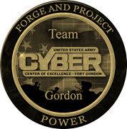
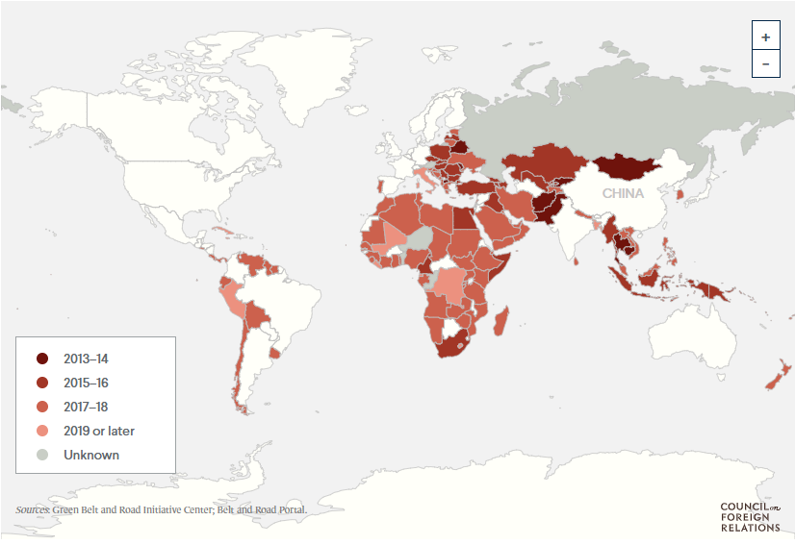
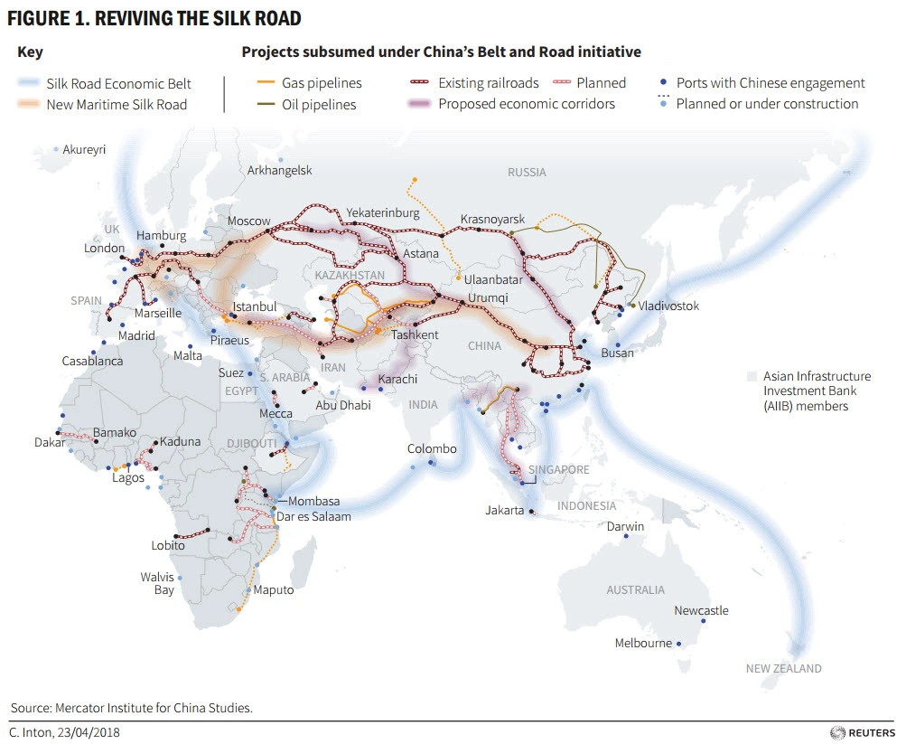
How They Fight Series
(U) China’s Belt and Road initiative
(U) This infographic describes the China’s Belt and Road Initiative (BRI). Known within China as the One Belt One Road, This 2013 infrastructure development strategy sought to connect countries in Central, South, and Southeast Asia with China. In the two years following BRI’s launch, ten countries formally joined the initiative by signing a memorandum of understanding (MoU) or cooperation agreement. In 2015, however, BRI significantly began expanding as an additional seventeen countries joined. In the fall of 2017, BRI was incorporated into the Chinese Communist Party’s constitution. BRI is now a truly global endeavor: thirty-nine countries in sub-Saharan Africa are signatories to the initiative, as well as thirty-four in Europe and Central Asia, twenty-five in East Asia and the Pacific, eighteen in Latin America and the Caribbean, seventeen in the Middle East and North Africa, and six in South Asia. Over 150 members of BRI, including China, account for 40 percent of global GDP. Sixty-three percent of the world’s population lives within the borders of BRI countries.
U.S. Concerns
The economic benefits of China’s investments in developing countries while others note that China is introducing unsustainable debt obligations and opportunities to gain concessions.
China tends to extend the duration of its loans, rather than forgive debt repayment, which creates long-term financial dependencies. Credit and loan terms are generally opaque and China tends to settle agreements bilaterally.
Some experts are concerned BRI undermines the role and principles of multilateral institutions, which collaborate with China on some of its projects.
Some defense analysts assess that some of China’s civilian infrastructure projects also have military applications
Scope and Objectives
One Belt, One Road aims to develop China-centered and controlled:
Global infrastructure
Transportation
Trade
Production networks.
The initiative seeks to expand China’s state firms’ presence overseas, create new markets for China’s goods and services, and secure access to foreign sources of agriculture, energy, and strategic commodities required for China’s economic development and policies.
BRI emphasizes economic policy coordination, trade and investment facilitation, dispute settlement, tourism, student and personnel exchanges, and cooperation in research and development, standards, and media.
BRI focuses on infrastructure, and related supply chain, transportation, technology and financial integration that expands the use of China’s credit information system and currency.
Projects in energy (supply, generation, and transmission), ICT, manufacturing (industrial parks and trade zones), and transportation (rail, roads, ports, and airports) look to vertically integrate China’s production supply chains, technology and service infrastructure, and transportation networks.
Initially focused on Asia, Europe, and Africa, the scope has become global and encompasses over 100 countries, including the United States. It includes a land-based “Silk Road Economic Belt,” a “21st Century Maritime Silk Road,” and a “Digital Silk Road” that seeks to promote overseas China’s information and communications technology (ICT) supply chain, including hardware, and optical cable and satellite networks, and newly revitalized “Health Silk Road.”
More Information/Sources:
https://www.cfr.org/blog/countries-chinas-belt-and-road-initiative-whos-and-whos-out
https://www.brookings.edu/articles/chinas-belt-and-road-the-new-geopolitics-of-global-infrastructure-development/
https://crsreports.congress.gov/product/pdf/IF/IF11735
Notes:
Sources:
https://www.cfr.org/blog/countries-chinas-belt-and-road-initiative-whos-and-whos-out
https://www.brookings.edu/articles/chinas-belt-and-road-the-new-geopolitics-of-global-infrastructure-development/
https://crsreports.congress.gov/product/pdf/IF/IF11735

